Slide 1

Exercise 5: Web Chat

Slide 2
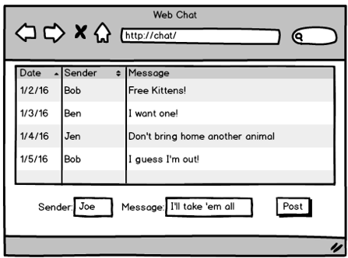
Exercise 5: Web Chat
Create a web interface for your CorkBoard object from exercise 1.
The user should be able to:
See the list of messages
Post a new message to the board
Optional: Clear the board
Optional: Filter based on names
Be as creative as you like, but you only need one request handler that generates one page with one form and one button. Add more as you see fit!

Slide 3
Exercise 5
URL parameters
GET does everything
Doesn’t have to be a table. A list is fine.
Send command to the server. Get back this same form and new list of messages

Slide 4
Hints
Here are some hints and ideas to get you started.
Start with the request handler:
What parameters are you going to take in the URL?
Stub it out by returning a simple “OK”.
Use the browser to send requests. Put your test parameters in the URL.
Extract and print the parameters in your handler code.

Slide 5
Hints
Add in the CorkBoard:
Copy your CorkBoard code into your new project.
Implement the Tornado request handler code to talk to the CorkBoard object
Print the responses from the CorkBoard object with print statements.
Still return a simple “OK” at this point.
Use the browser to test the code.

Slide 6
Hints
Experiment with a static HTML file:
Add a list (or table) of example messages.
Add the form and fields.
Press the send button and check the parameters in the URL line.
Use the form to test your Tornado server.

Slide 7
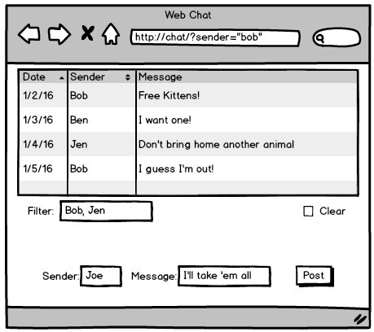
Hints
Flesh out the request handler:
Add “write” statements to your handler to return the full HTML.
Copy lines from the static HTML page you just created.
Test, test, test! Try multiple browser windows. Have a nice chat with yourself!

